Slide 1
Generated Events
Folder name : "Param 3rd try xi = 0.2 1M"
- "Param 3rd try" = parameters 3rd fit = Following set of parameters :
A | B | C | D | A1 | A2 | B1 | B2
-0.762658 | 1.14336 | 4.65073 | 1.25921 | -0.278177 | 0.030361 | 0.257899 | -0.480634
- "xi = 0.2" : Value of ξ
- "1M" : Number of initial points : Reduced through Monte-Carlo events generation
(indicator of efficiency as it is not saved otherwise)
Files
- Events : "myEventsDistrib.txt"
- Used form factors : "parameters.txt"

Slide 2
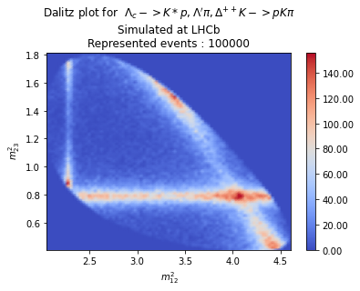
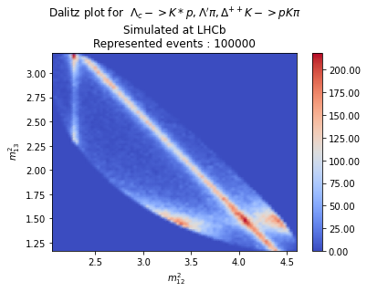
Dalitz plot of events generated at LHCb
LHCb s12 s23
LHCb s12 s13

Slide 3
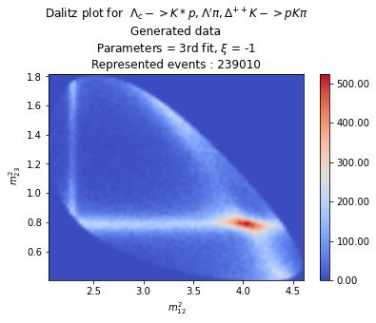
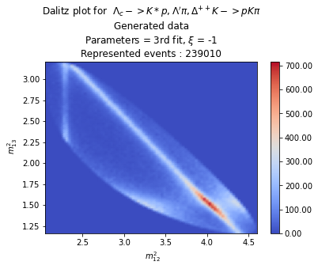
Param 3rd try xi = -1 3M
3rd fit xi = -1 3M s12 s23
3rd fit xi = -1 3M s12 s13

Slide 4
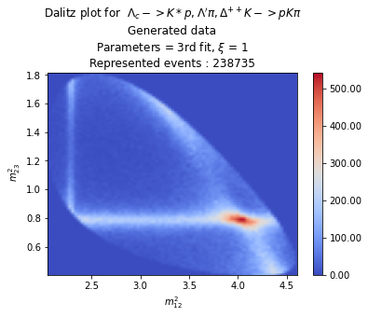

Param 3rd try xi = 1 3M
3rd fit xi = 1 3M s12 s23
3rd fit xi = 1 3M s12 s13

Slide 5
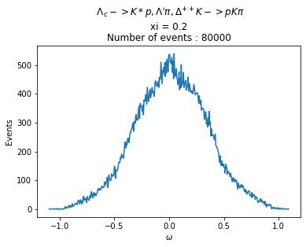
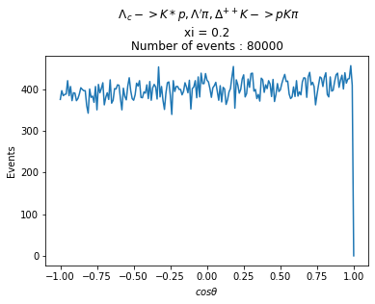
Param 3rd try xi = 0.2 1M (100k final events)
3rd fit xi = 0.2 1M 80k events omega distrib
3rd fit xi = 0.2 1M 80k events cos distrib

Slide 6
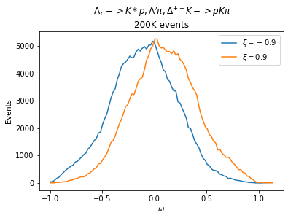
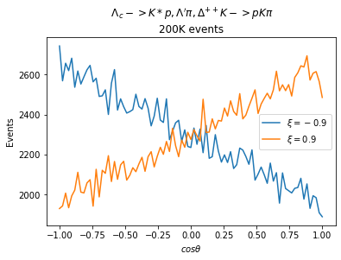
Sensitivity study (xi = +/- 0.9)
3rd fit xi = -0.9,0.9 3M 200k events
omega comparison
3rd fit xi = -0.9,0.9 3M 200k events
cos comparison
xi = <w>/<w²> = 0.897151
Sigma for xi = 0.9 : 0.005459
xi = <w>/<w²> = -0.902771
Sigma for xi = -0.9 : 0.005642

Slide 7
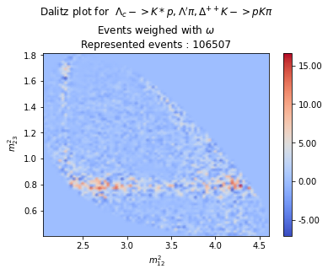
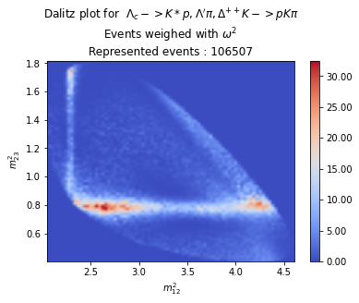
Weighed Dalitz
3rd fit xi = 0.2 1M s12 s23
omega weighed
3rd fit xi = 0.2 1M s12 s23
omega squared weighed

Slide 8
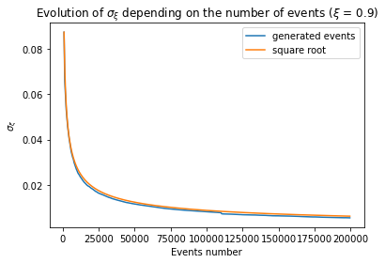
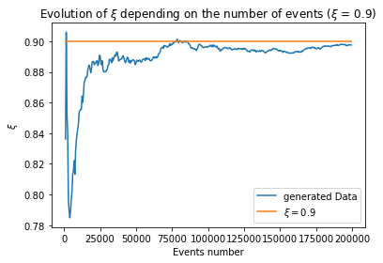
Evolution of ξ and σ_{ξ} depending on sample size
3rd fit xi = 0.9 3M sigma xi evol
3rd fit xi = 0.9 3M xi evol
Evolution of σ_{ξ} depending on sample size. Comparison with simple square root scaling
Choosen events = first N of generated events (N = sample size)

Slide 9
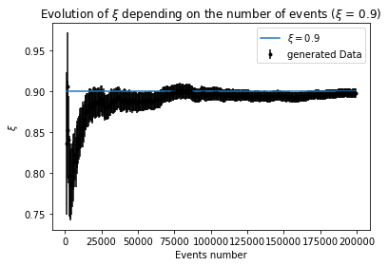
Evolution of ξ and σ_{ξ} depending on sample size
3rd fit xi = 0.9 3M xi, sigma xi evol
Evolution of ξ with σ_{ξ} depending on sample size.

Slide 10
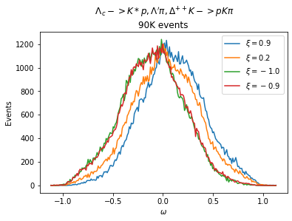
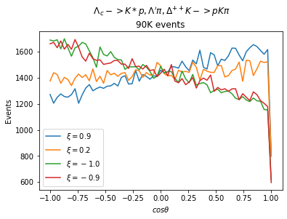
Many xi comparison
3rd fit 90k events omega comparison
(xi = -1, -.9, 0.2, 0.9)
3rd fit 90k events cos comparison
(xi = -1, -.9, 0.2, 0.9)
xi = 0.895065
Sigma for xi = 0.9 : 0.008594
xi = 0.205461
Sigma for xi = 0.2 : 0.010108
xi = -0.996626
Sigma for xi = -1.0 : 0.007645
xi = -0.899109
Sigma for xi = -0.9 : 0.008497

Slide 11
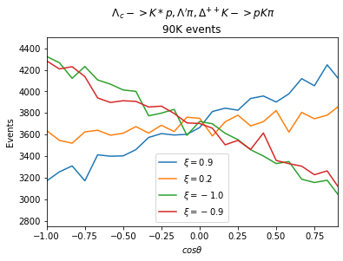
Many xi comparison
3rd fit 90k events zoomed cos comparison
(xi = -1, -.9, 0.2, 0.9)
xi = 0.895065
Sigma for xi = 0.9 : 0.008594
xi = 0.205461
Sigma for xi = 0.2 : 0.010108
xi = -0.996626
Sigma for xi = -1.0 : 0.007645
xi = -0.899109
Sigma for xi = -0.9 : 0.008497

Slide 12
Fit of form factors
How to :
Use macro "FitParametersFromEvents.Cxx" with one parameter : Repertory of events set
Process
Fit form factors using a set of events (only needs repertory of events set)
Done in "FitParametersFromEvents.Cxx" and concerns the 8 initial form factors
D = \frac{1}{\sum_{i=1}^8 X_i * f_i }
Normalization factor, where X_i are the form factors and f_i the corresponding integrated
Parts of $d\Gamma$
Minimize L =- \sum_{events} log(D*\sum_{i=1}^8 X_i * f_x_i (event))
Where f_x_i are the parts of $d\Gamma$ decomposed corresponding to form factors but
Not integrated
In the program : compute f_i externally (better results) on Mathematica, and f_x_i in the
Program (but before minimisation for optimisation)
More :
Fit with 20 "final" form factors (A^2,B^2,ReAB,...) done in the same way with
"FitParametersFromEvents20param.Cxx"

Slide 13
Fit of form factors
Results :
Printed (cout) in command window :
- success (or not) of the minimisation
- Minimum L
- Number of calls
In files :
- Correlation in "correlation.csv"
- Covariance in "covariance.csv"
/!\ "Parameters.txt" is used for events generation and does not contain the fit results, you have
To save them by hand /!\

Slide 14
Fit of form factors
Common issues :
- Does not converge
- A parameter is set to 0
- Absurd value
Likely issue :
- Dependent on starting point for minimization
Results
Name | A | B | C | D | A1 | A2 | B1 | B2
Default | 1 | 1 | 1.2 | 1.2 | 0.083 | 0.083 | 0.083 | 0.083
Emi 1k | -0.51885 | 0.720197 | 3.21027 | 0.690193 | -0.199773 | 0.0273488 | 0.153403 | -0.359596
Emi 2k | -0.79424 | 2.70137 | 12.9829 | 2.55742 | -0.705464 | 0.082651 | 0.574873 | -1.21017
First try 10k | -0.377112 | 1.12888 | 5.37062 | 1.13337 | -0.238214 | 0.00294509 | 0.259437 | -0.493586
First try 100k | 0.921021 | 33.9734 | 2.20999 | 3.38624 | 16.7798 | 0.387535 | 39.8313 | 10.2264
Second try 100k | -0.767655 | 1.15095 | 4.68177 | 1.26753 | -0.280015 | 0.0305579 | 0.259608 | -0.483822
Third try 100k | -0.762658 | 1.14336 | 4.65073 | 1.25921 | -0.278177 | 0.0303613 | 0.257899 | -0.480634

Slide 15
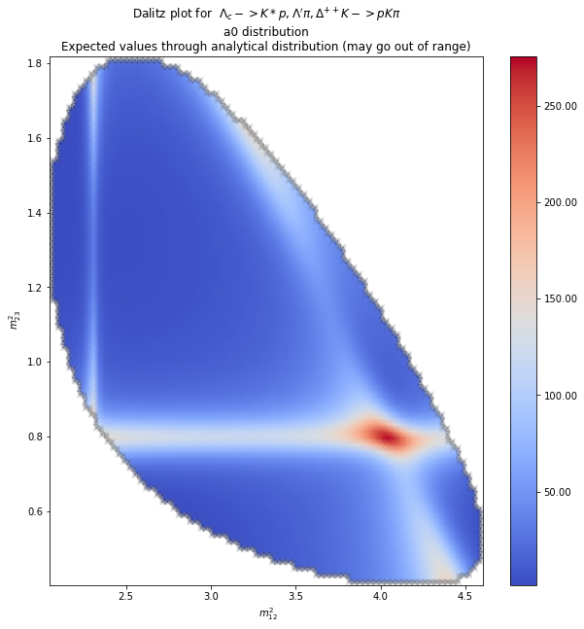
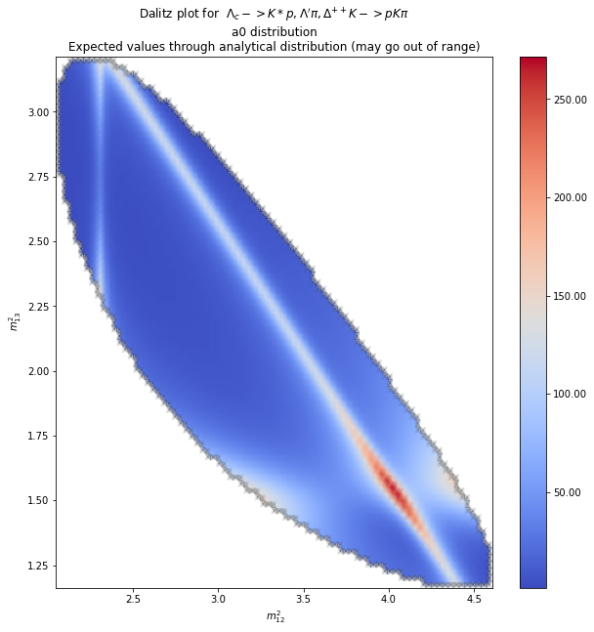
Analytical plot for to analyse fits
3rd fit analytical s12 s23
3rd fit analytical s12 s13

Slide 16
Fit of form factors
Fit of 20 form factors
20 param fit
A2 = 0.933412 +/- 0.590964
B2 = 0.434954 +/- 0.0538418
C2 = 15.4867 +/- 3.49629
D2 = 0.294159 +/- 0.150956
A12 = -0.418216 +/- 0.0690142
A22 = 0.0652099 +/- 0.0101138
B12 = 0.0713721 +/- 0.00605586
B22 = -0.303079 +/- 0.105121
ReA1A2 = 0.0495278 +/- 0.00449477
ReB1B2 = 0.083722 +/- 0.0302653
ReAD = -3.35499 +/- 0.462021
ReBC = -0.360355 +/- 0.29646
ReA1C = -0.906412 +/- 0.54992
ReA2C = 1.04299 +/- 0.434015
ReB1D = 0.0480193 +/- 0.0467684
ReB2D = -0.451826 +/- 0.11817
ReA1B = -0.123029 +/- 0.022331
ReA2B = 0.143617 +/- 0.0156009
ReB1A = -0.134177 +/- 0.0227368
ReB2A = -1.25249 +/- 0.181267

Slide 17
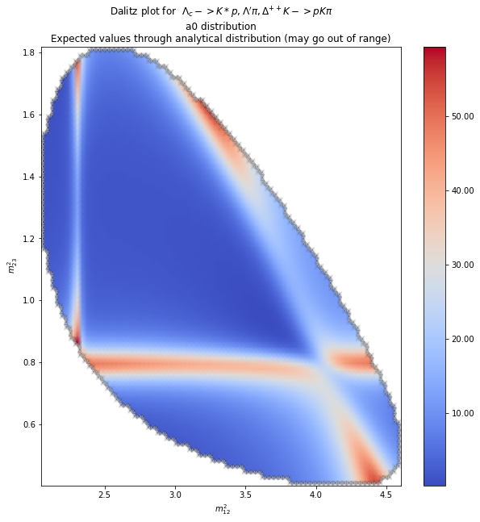
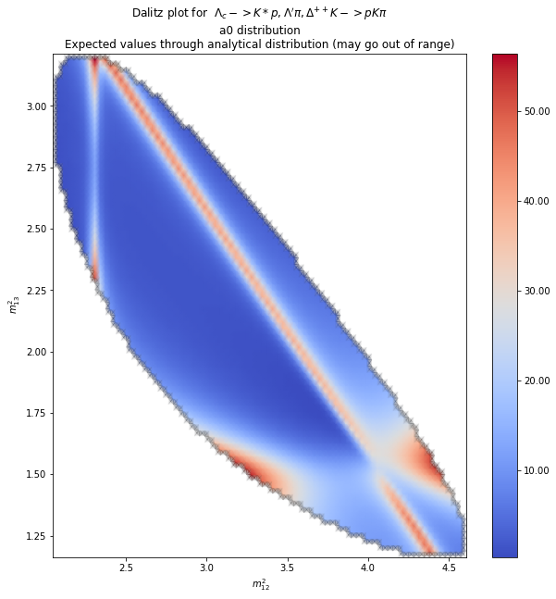
Analytical plot for to analyse fits
20 fit analytical s12 s23
20 fit analytical s12 s13

Slide 18
Generating events
How to :
Use "generate.C" macro with parameters : (number of events for flat distrib, xi value)
Note that there is no default xi value.
Process (printed at each step)
- Generate flat Dalitz + flat phi + flat cosTheta distributions which are saved in "FlatEvents.txt"
- Loads form factors from "parameters.txt"
(- Gets 20 "final form factors" from them)
- Generates distribution from flat distribution (filters randomly according to probabilities)
- Saves it in "myEventsDistrib.txt"
To take care :
- "parameters.txt" has to be set by hand beforehand
- "myEventsDistrib.txt" and "FlatEvents.txt" will reset, make sure to save previous generation
Before starting new one
- The final number of events is not the input parameter for practical reasons : Get efficiency of
Generation, easier computation, comparison of generation time.
It is usually around 1/10th of the flat distribution
- If you are using git files, they are in a separate folder for save, but you have to put them in main
Folder for them to work (dependencies)

Slide 19
Generating events
Results :
Table of events distributed according to $d\Gamma$ with corresponding
(s12,s23,cosTheta,phi,a0,b0,b1,omega) in "myEventsDistrib.txt"
That way analysis does not need long computing

Slide 20
Prospects :
More analysis on fit
- try new ones with more events from LHCb
- Uncertainties ?
- New starting point ?
A bit more omega analysis
- xi = -0.2 and xi = -0.5 for sensitivity

